Slide 1
Project 3: RemiX A STORY
HANNAH AVERY

Slide 2
BEAUTY & THE BEAST

Slide 3
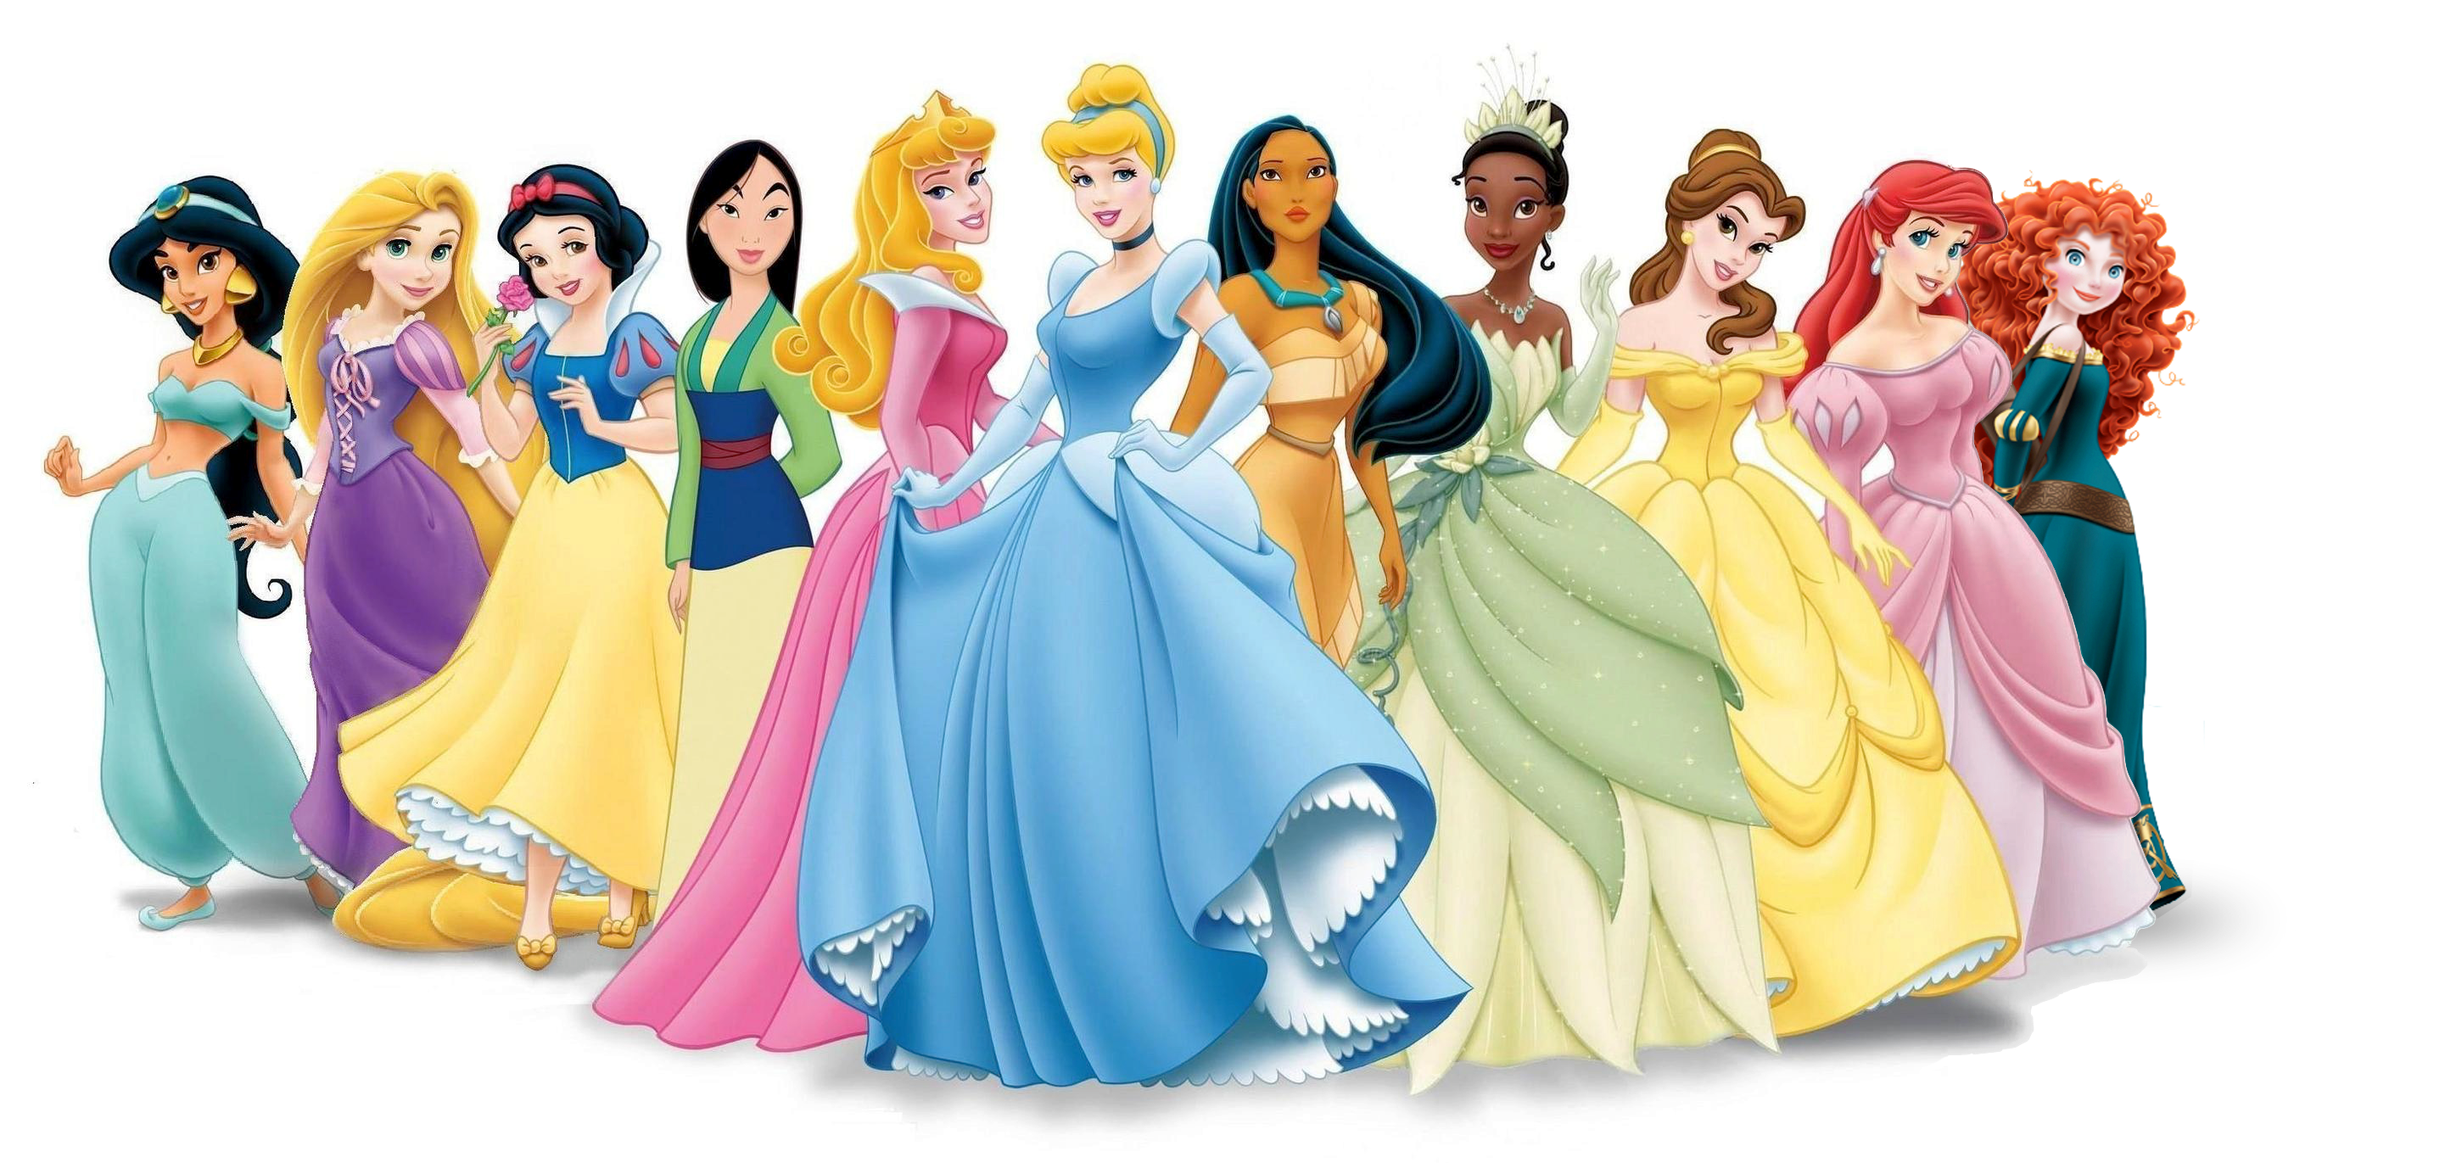
RHETORICAL CHOICES
Purpose
Audience
Context
Genre

Slide 4
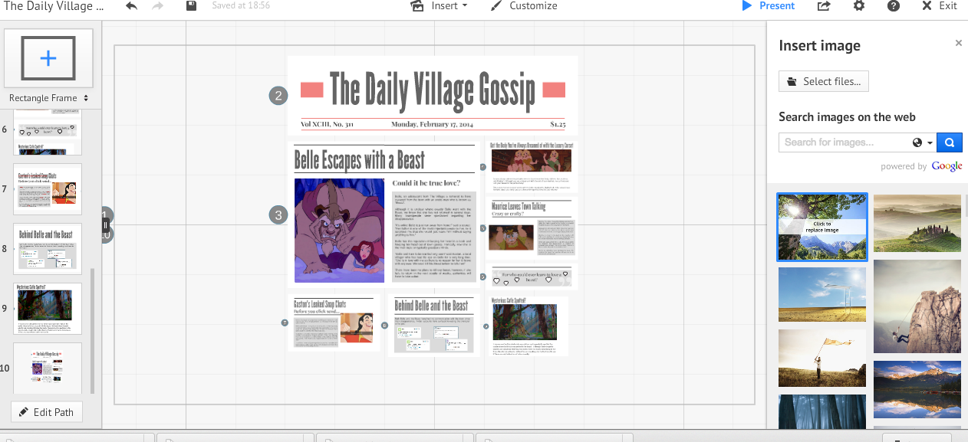
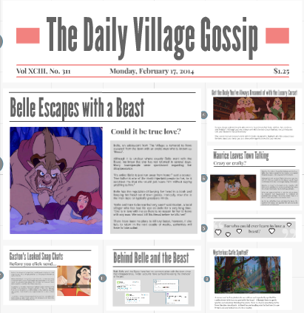
DESIGN
Emphasis
Alignment
Organization

Slide 5
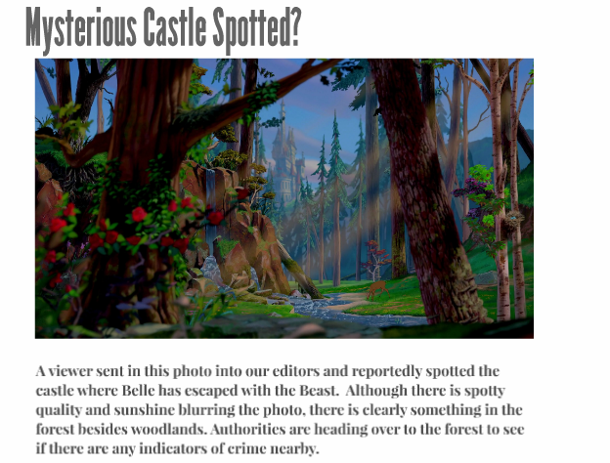
MODES OF COMMUNICATION
Spatial
Linguistic
Visual

Slide 6
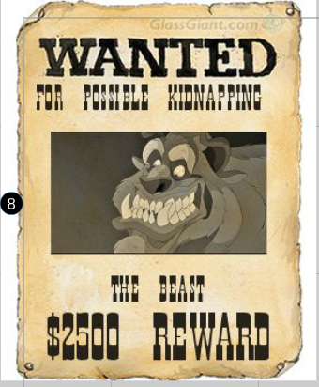
SUCCESSES, CHALLENGES & RISKS

Slide 7
SOURCES
Ballroom dance: www.Confusedmatthew.com
Belle Sees Prince: www.fanpop.com
Scary Teeth: www.aahabershaw.wordpress.com
Belle and Gustan: www.tom1st.com
Belle Reading: www.movieguide.org
Gaston Muscles: www.earnthis.net
Three Girls: www.blogs.disney.com
Gaston Drowned: www.fanpop.com
Beast Defending Belle: www.atomoicthinktank.com
Gaston Open Arms: www.huffingtonpost.com
Library Picture: crunchingsandmunchings.wordpress.com
Belle with Goats: imgkid.com

