Slide 1
COWBIRD: Interrogating an Interface
By Celsea Copas

Slide 2
About Cowbird

Slide 3
Mission Statement

Slide 4
Joining

Slide 6
Organization

Slide 7
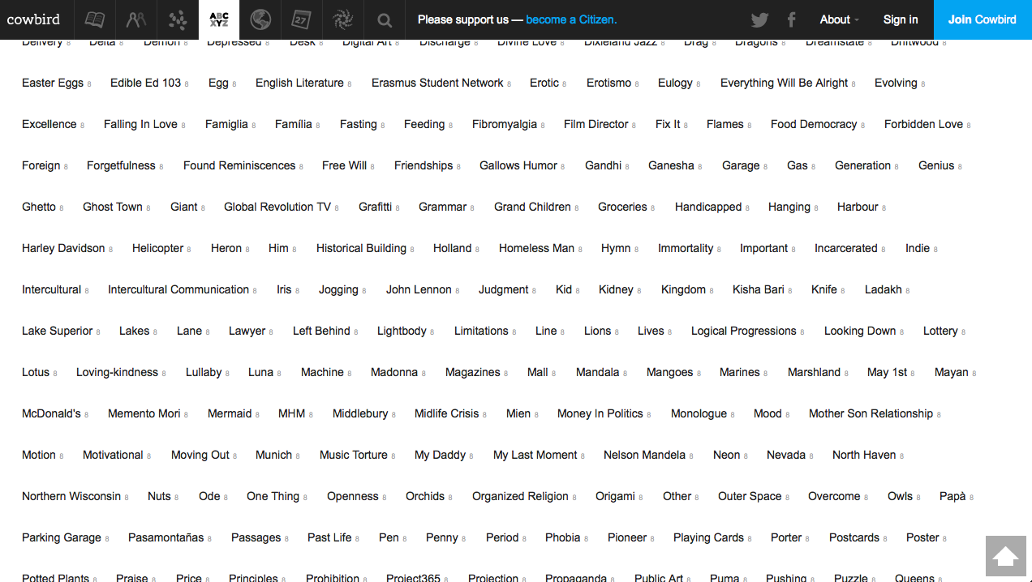

Slide 8
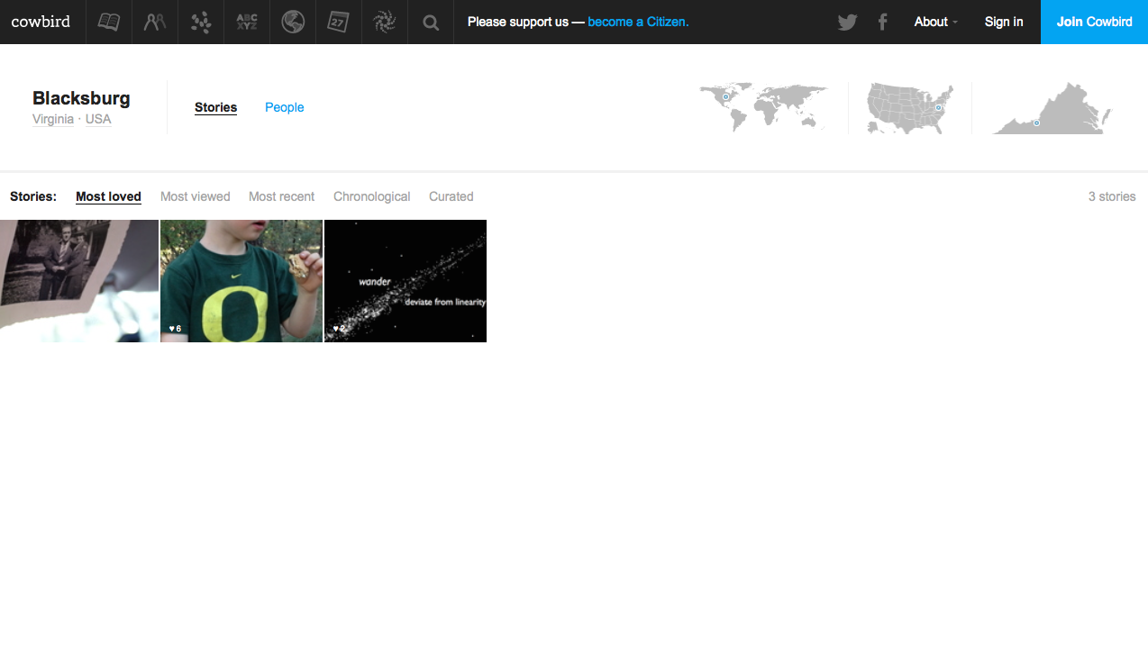

Slide 10
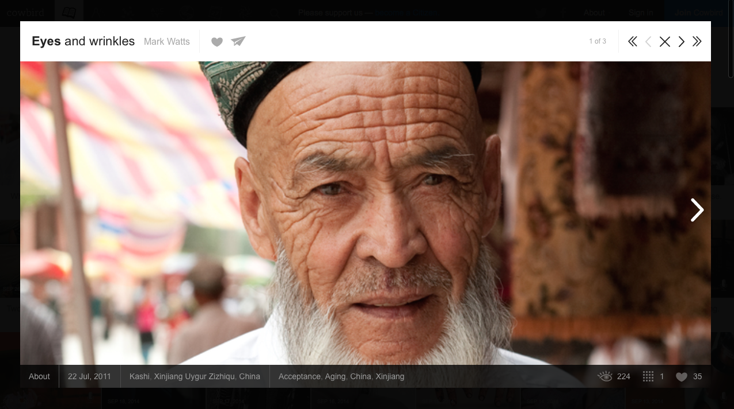
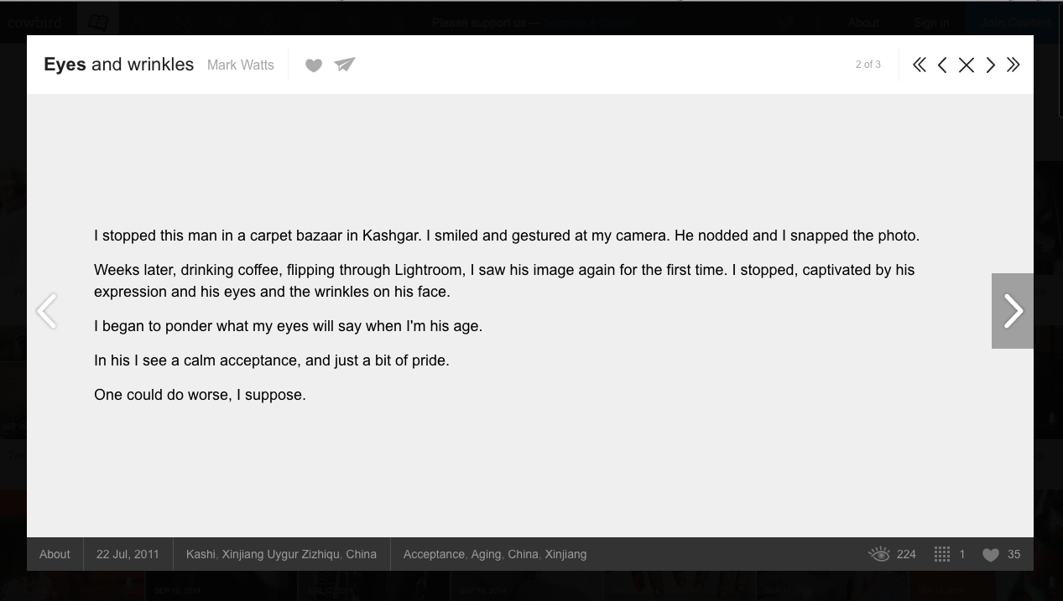
Stories

Slide 14
Constraints

Slide 16
Questions??

